Slide 1
BOOTING INTO AI: Startup instructions for teaching artificial intelligence
Brian K. Hare University of Missouri-Kansas City
David Heise Lincoln University

Slide 2

Who are we?
Brian Hare, MS UMKC
Urban public (state system) university
CS, IT, ECE programs ABET Accredited
Designed/taught Intro. to AI course
David Heise, Ph.D., P.E. Lincoln University
Public, land-grant, historically black university, founded in 1866 by Civil War veterans
CS, CIS, MBA/MIS programs
Reintroduced AI course with computational intelligence focus

Slide 3


Why are we here?
Think this….
Not this

Slide 4
Who is this for?
Faculty without an AI background,
Who nonetheless are given responsibility for an AI course,
Which usually implies they’re at a smaller school without a deep bench of AI expertise on site
“It’s not my area either, but we’ve got to offer something for our students.”
Slides & materials are available at: http://bit.ly/BootingIntoAI

Slide 5
Basic ideas
Don’t panic!
Artificial Intelligence and Machine Learning are big enough areas that you CAN’T cover everything in depth – it is inherently a process of curation & selection
This is a large degree of freedom, and a large challenge
Broad overview or tight focus?
Traditional AI or computational intelligence?
Theory-based, application based, or technique-based?
Conceptual or hands-on?
Degree of rigor?
How does this course fit into the curriculum?

Slide 6
Workshop outline
Part I – A Whirlwind Tour of AI
Major applications of AI
Natural Language Processing
Computer Perception
Statistical & Machine Learning
Robotics, Autonomous Planning, Scheduling
Techniques & Tools
Searching and its many variants
Knowledge, reasoning, planning
Uncertain knowledge (Probabilistic analysis, fuzzy systems)
Learning from examples – Decision Trees, Neural Systems
Unsupervised learning – grouping “like” things
Part II – Let’s Talk Coursework
Sample Syllabi & Assignments
Resources
Open forum / Roundtable / Brainstorm

Slide 7
A whirlwind tour of artificial intelligence & machine learning
Major Divisions/APPLICATIONS within AI

Slide 8
NATURAL LANGUAGE PROCESSING
Statistical analysis of text
Machine translation
Sentiment analysis
Semantic analysis & classification
Machine composition & automatic journalism
Information retrieval
Information extraction

Slide 9
Computer perception
Image analysis
Edges, Color & Texture
Segmentation
Shading
Movement detection
High level features & classification
Text extraction
Speech to text
Speech generation
Automated speech translation
Non-speech audio / music processing

Slide 10
Statistical & Machine Learning
Learning from examples
Reinforcement
Supervised
Linear classifiers (regression models)
Inductive learning
Learning probabilistic models

Slide 11
Knowledge engineering
Knowledge representation
Expert systems
Knowledge extraction
Semantic Web

Slide 12
Robotics, Autonomous Planning, Scheduling
Autonomous Vehicles
Automated Assembly
Route Finding
Job scheduling

Slide 13
A whirlwind tour of artificial intelligence & machine learning
Techniques & Tools

Slide 14
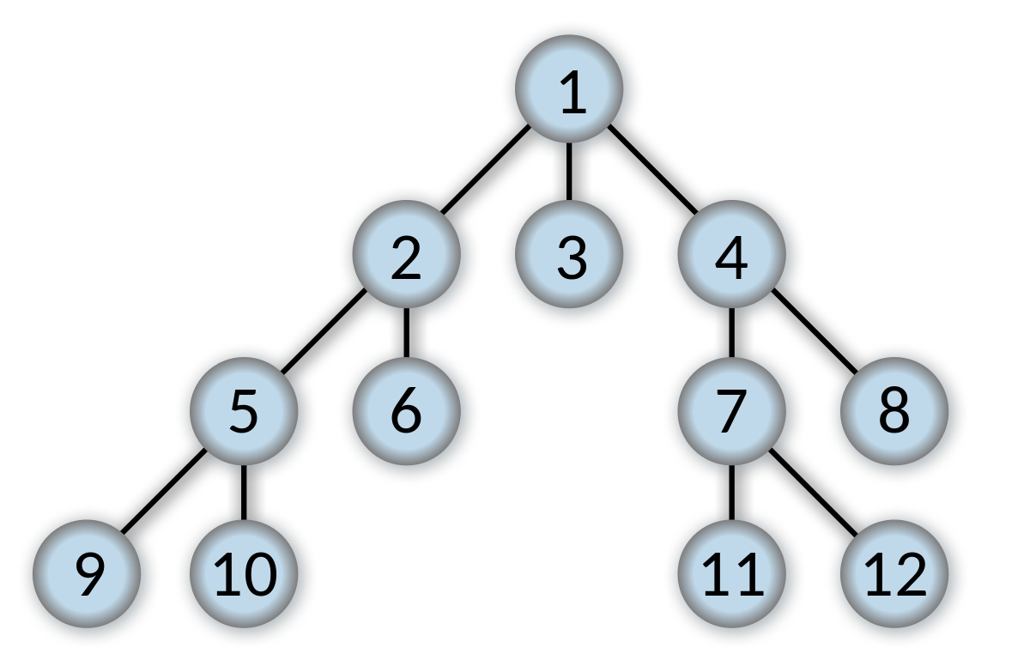
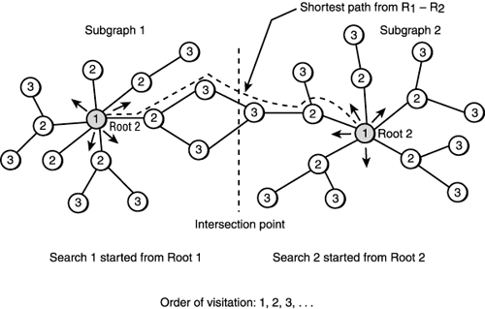
Classical uninformed Search
Breadth first
Depth first
Depth-limited
Iterative deepening
Uniform Cost
Bidirectional

Slide 15
Classical Informed (heuristic) search
Greedy best-first
Recursive best-first
Backs up scores of leaves to reduce memory demands
Selection/generation of admissible & consistent heuristics
Reduced problems
Relaxed problems
Learning from experience
Most others are variants of A*, minimizing F(n) = g(n) + h(n)
Actual cost from start to node n + estimated (heuristic) cost from n to goal
Memory-bound A*
Iterative-deepening A*

Slide 16
Other Search
Hill climbing (greedy local search)
Generate successors, pick the one that looks best
May get stuck on local maximum
Stochastic hill climbing
Randomly choose from all ‘uphill’ moves, either uniform or weighted
Beam search
Start with k states, generate multiple possible successors to all
Keep best k successor states, so promising successors spread through pool
These are all incomplete (not guaranteed to find solution)
Random restart is usual solution to getting stuck
Trivially, restart enough times & eventually you’ll randomly generate a goal state

Slide 17
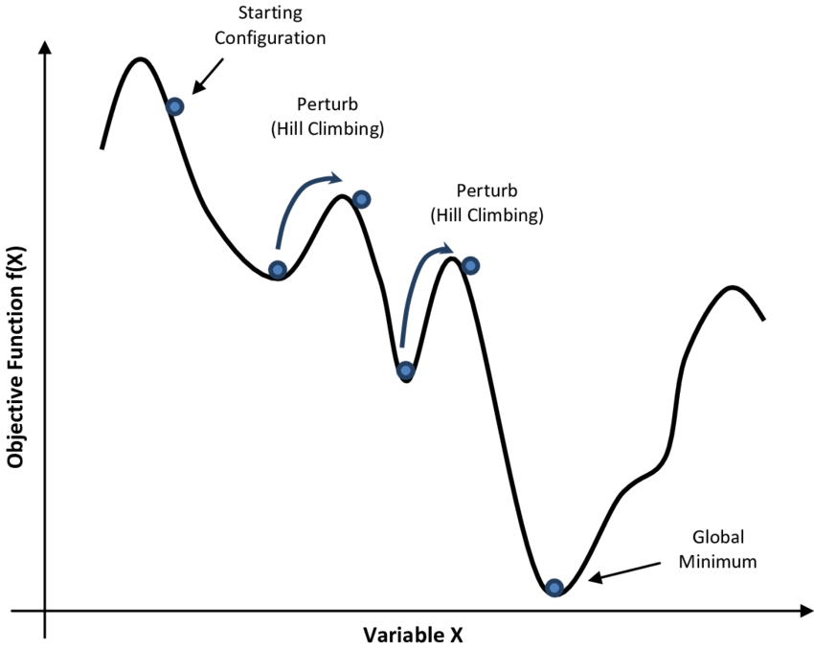
Simulated Annealing
From some starting state, generate successor randomly
If it’s an improvement (downhill), take it
If not, take it anyway as long as it’s not “too much” worse
Probability inversely proportional to size of increase
Gradually become stricter about how much is too much
Continue until convergence (no improvement in some large N of trials)
Generalizes to multiple conflicting goals – objective function can be arbitrarily complex
Used in VLSI layout, scheduling, routing, optimization

Slide 18
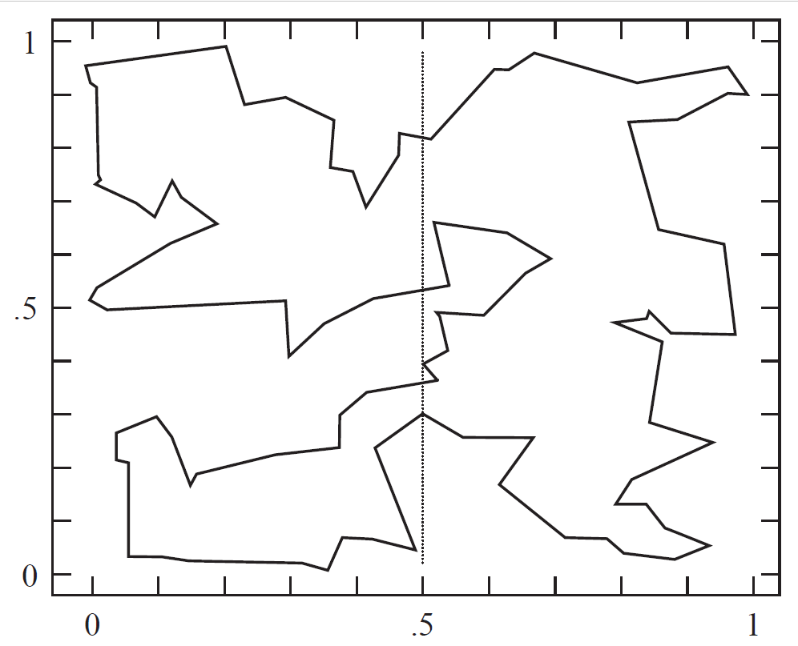
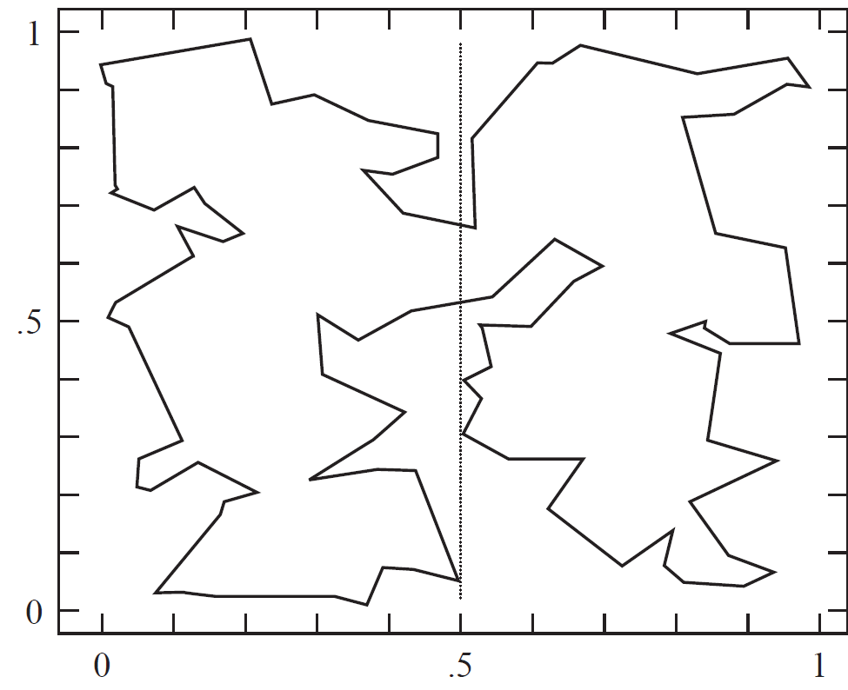
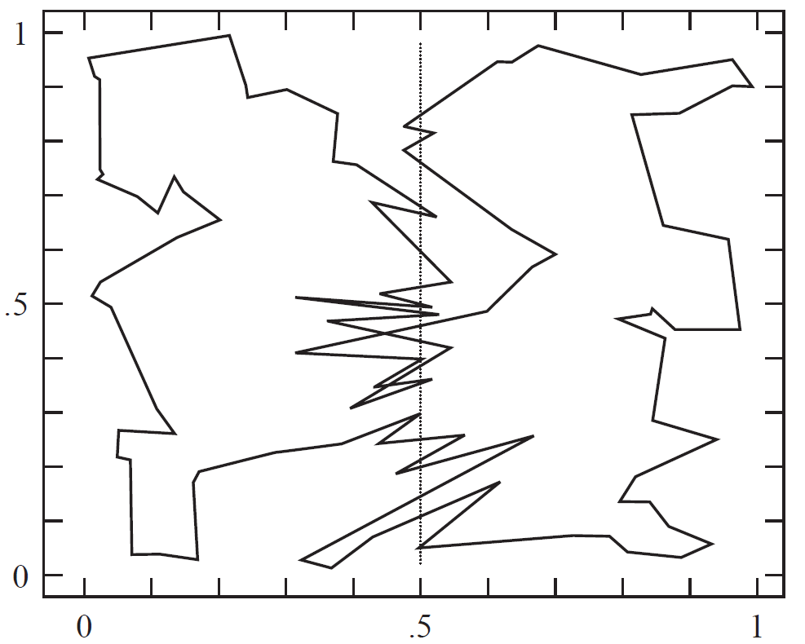

Slide 19
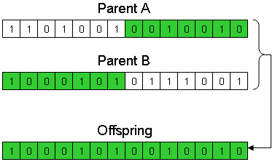
Genetic algorithms
Start with pool of candidates, rate on objective (‘fitness’) function
Remove low scorers
Generate replacements via combining 2 ‘parents’
Crossover (shown here)
Mutation
Repeat until solution found or ‘good enough’ fitness obtained
Used in circuit layout, scheduling, optimization

Slide 20
Genetic algorithms
Specify problem, define constraints, and how to define the optimum
Represent the problem as a chromosome (array of numeric values)
Define a fitness function to evaluate performance
Construct operators
Run the GA, tune its parameters

Slide 21
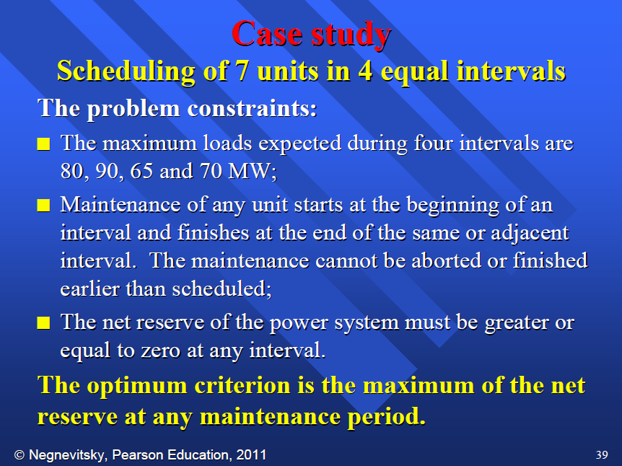
Genetic algorithms

Slide 22
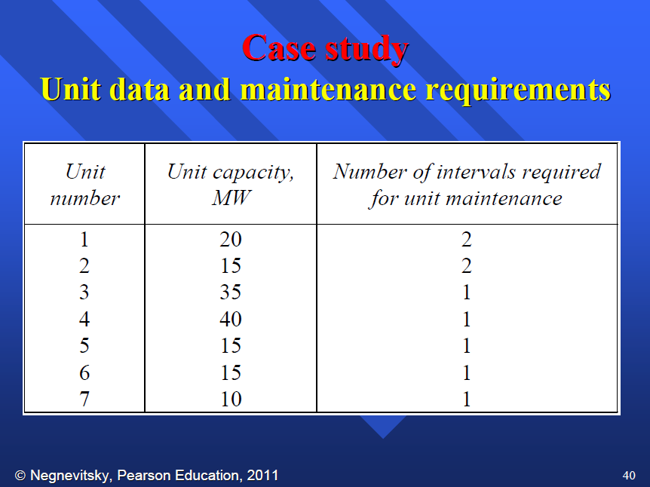
Genetic algorithms

Slide 23
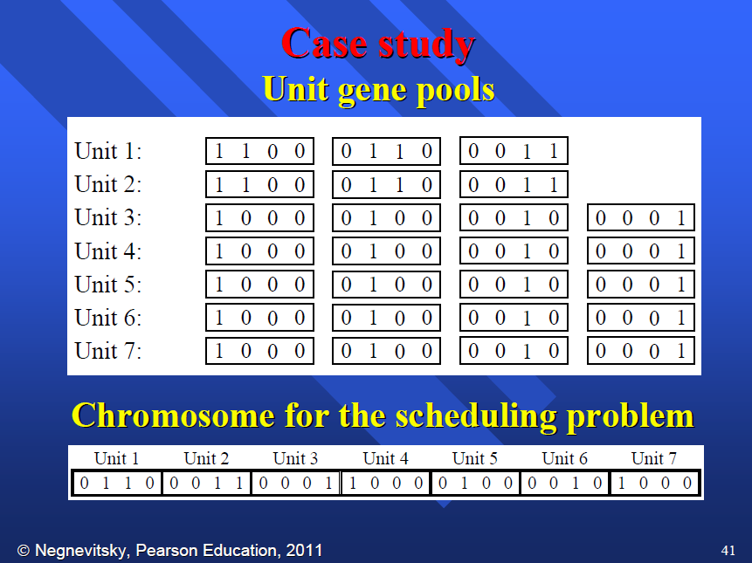
Genetic algorithms

Slide 24
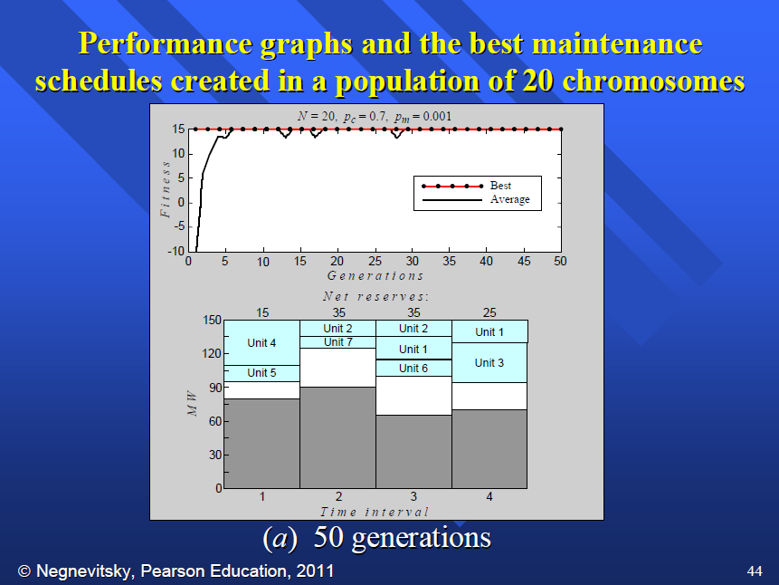
Genetic algorithms

Slide 25
Nondeterministic search
What if our actions don’t always work, or may have more than 1 possible result?
Need a strategy that works for any of the possible outcomes
Modeled by an AND-OR tree
OR nodes are choices we make; we do this OR that
But after making a choice, we must be ready for this result AND that result, as either might happen
Plan is successful if there is a goal state at each leaf, a valid choice made at each OR, and every path followed from each AND ends in a leaf

Slide 26
Partial or no observation
What if we can’t perceive some of the environment (or maybe not any of it, because we have no sensor)?
Must generate list of belief states (situations we could possibly be in) and apply search algorithm to those
If actions are reversible (environment can be safely explored) we can choose actions that are helpful in ANY state we might be in
If actions are potentially irreversible (e.g. we might fall off a cliff) we should choose only those actions that are safe in ALL states we might be in
The number of possible states may be very high—need a way of specifying higher-level information, e.g. “I’m at least 2 feet from the wall.”
Or we may take a sample—we don’t have time to analyze all possible hands everyone else at the poker table may have, so we generate a few dozen to few hundred hands & estimate

Slide 27
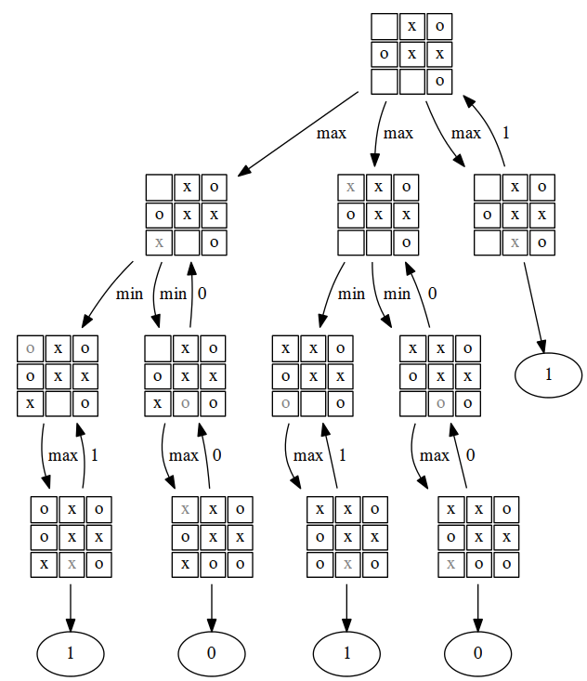
Adversarial Search (Games)
Can’t search game tree out to the end, need evaluation function
Minimax algorithm
Alpha-beta cutoff increases speed
Probabilistic alpha-beta increases it more
Various methods & heuristics (killer moves, quiescence checks, transposition tables) to improve speed or reliability
Forward pruning fast but dangerous (may unknowingly cut off the optimum branch)

Slide 28
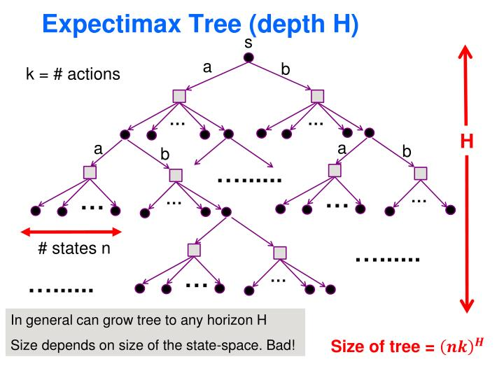
Stochastic games
In some games there’s an element of randomness as to what moves are legal (e.g. backgammon--roll the dice then select move)
Add extra layer (chance nodes) to weight by probability
Tree is larger but search methods essentially the same
To deal with explosion in tree size, some form of sampling is often used to produce estimate

Slide 29
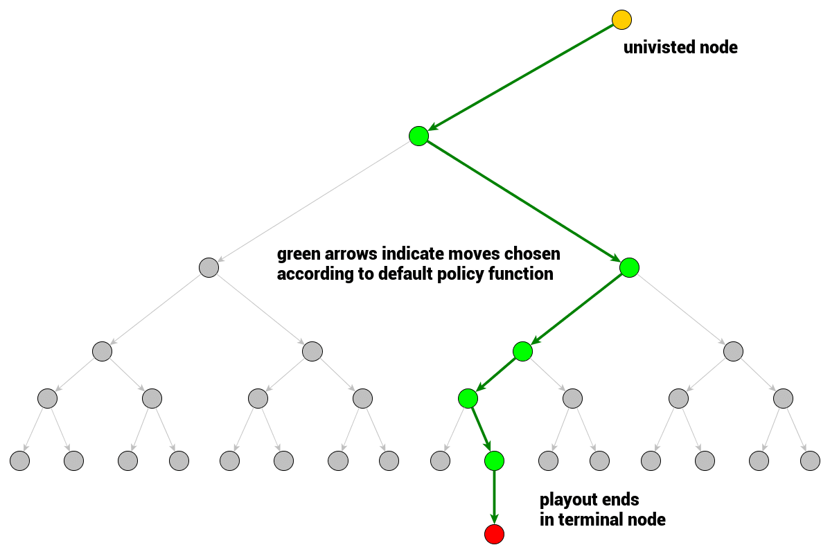
Monte carlo tree search
Randomly select moves until terminal state is reached
Light playout: move selection purely random
Heavy playout: move selection weighted by probability a given move is best according to some evaluation. Useful if there are many possible moves but only a few good moves.
Propagate back up tree, counting win/loss/draw (payout)
Selection method strikes balance between further exploration of promising nodes & re-checking nodes that haven’t been tried in a while
This was the method used by Google Alpha Zero to learn world-championship level chess in 2 days and world-championship Go in 2 weeks
MC tree search data used to train neural network

Slide 30
Constraint satisfaction
Given a set of variables X with possible values D, find an assignment of values to variables such that all constraints are satisfied
Map coloring (adjacent areas must have different colors), job scheduling (some must complete before others can start, some can’t be done simultaneously)
Form graph of constraints (variables are nodes, constraints between them are edges)
May also have global constraints such as alldiff
May have preference constraints
Can apply constraint propagation to reduce search space further by eliminating possible values for a variable
Search through remaining state space using standard backtracking search
Heuristics can guide choice of where to look next, so faster than brute force
Local search methods also work very well
Some problems (e.g. Sudoku) can be solved without search just by applying constraints; otherwise constraints reduce remaining search space

Slide 31
Propositional Logic
Expresses knowledge as various statements that are true or false, connected with AND or OR.
Conclusions can be searched for automatically via resolution: A ∨¬B, B∨C implies A ∨ C
A knowledge base (KB) is built up based on what’s known originally and what can be deduced
Proof of statement a consists of showing KB and not-a is unsatisfiable. (So not-a cannot be true, so a must be true)
Most real-world problems aren’t this bad, but satisfiability is NP-Complete in worst case.
Simple and surprisingly powerful but no way to express general rules—”A piece may occupy only one square of the board at a time” requires “for time t, not-on-square A or not-on-square B” statements for every possible pair of squares A and B and time t
Thus the rules of chess, while expressible in propositional logic, would take thousands of statements

Slide 32
First-Order Logic
Expresses relationships between objects
Has qualifiers ∀, ∃ (Universal, for all; Existential, for some)
Various rules allowing manipulation of logical statements
Allows automation of various proof techniques
Modus Ponens is the workhorse
Forward chaining: Beginning with KB, find statements that can be combined; apply them. Continue until goal C emerges
Backward chaining: Find statement in KB allowing goal as its conclusion (if A and B, then C).
A and B are new goals; if both can be satisfied, goal is reached.
Suppose we find “If X and Y, then A.” Fine, put X and Y onto the list to be satisfied
This method avoids going down blind alleys.
Prolog uses backward chaining. Used for circuit verification, parser construction, logical proof

Slide 33
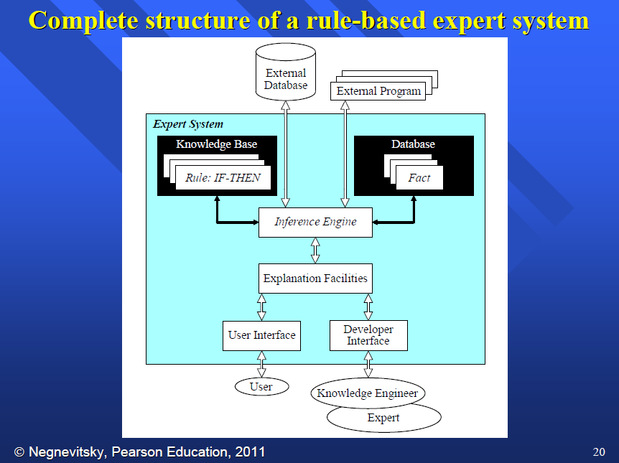
Expert Systems
Inference rules provided by domain experts or inferred statistically
Conclusions may be deterministic or probabilistic

Slide 34
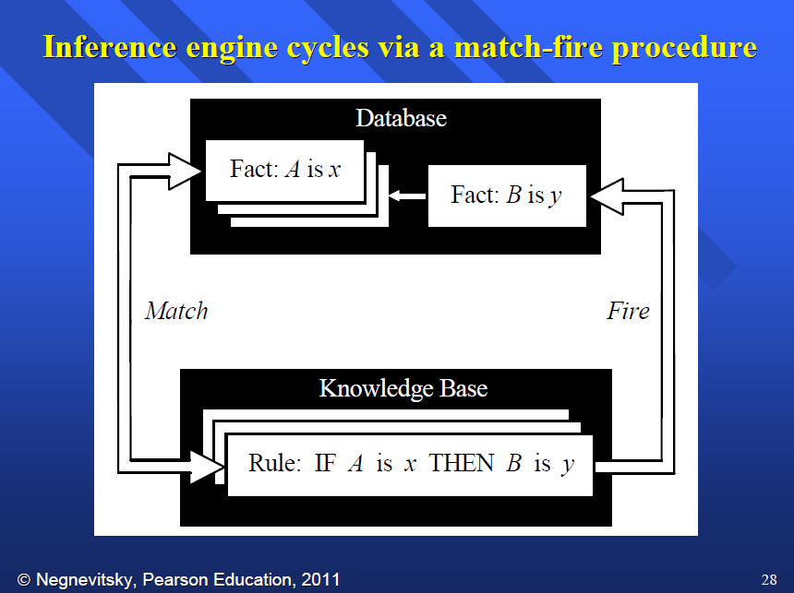
Expert Systems

Slide 35
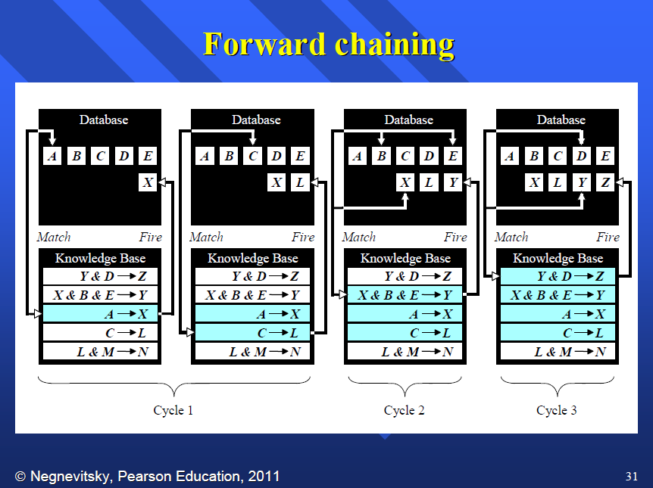
Expert Systems

Slide 36
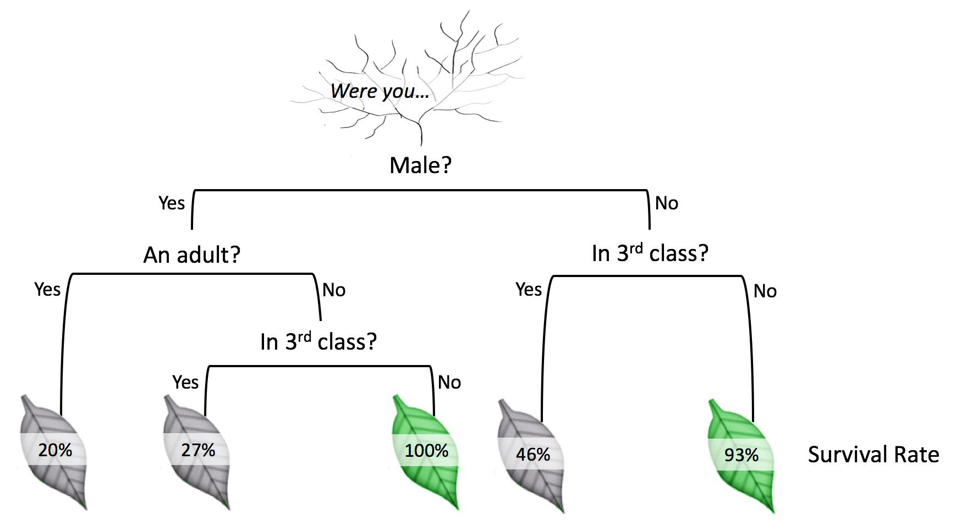
Decision Trees
Identification of variables that reduce uncertainty in classification
Often measured in information gain
Ideally, each leaf is homogeneous
Various methods of pruning to reduce risk of overtraining

Slide 37
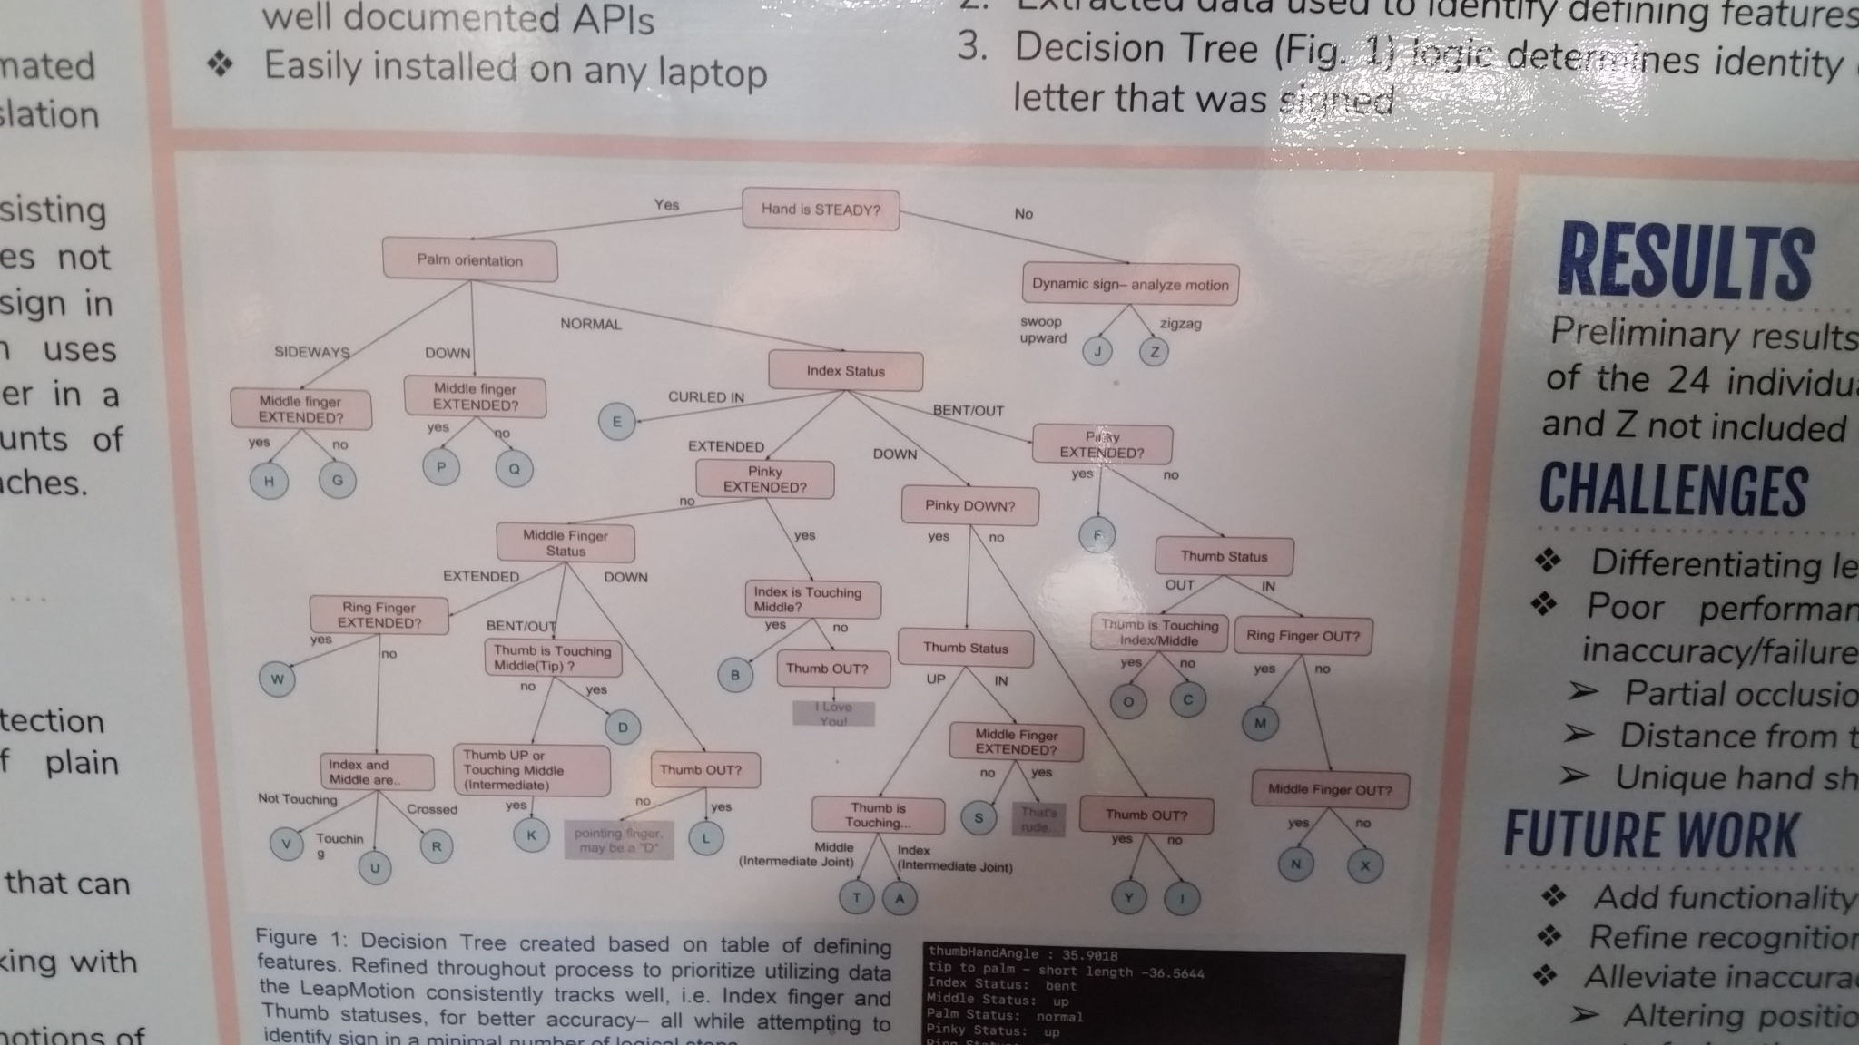
A decision tree from sigcse 2019
Identifying finger position to read ASL via machine vision. This was a student poster.

Slide 38
Probabilistic & Bayesian Reasoning
Application of conditional probabilities, esp. using Bayes’ Theorem
Allows answering “Given this effect, how probable is this cause?”
Naïve Bayes: Assume variables are conditionally independent
Not always realistic but keeps problems tractable
Exact computation of probabilities may (or may not) be possible
But sampling methods sometimes used to estimate intractable problems
Direct sampling, Likelihood Weighting, etc.
Dempster-Shafer Theory allows modeling ignorance as well as uncertainty
Certainty factors may be used when probabilities cannot be reliably estimated

Slide 39
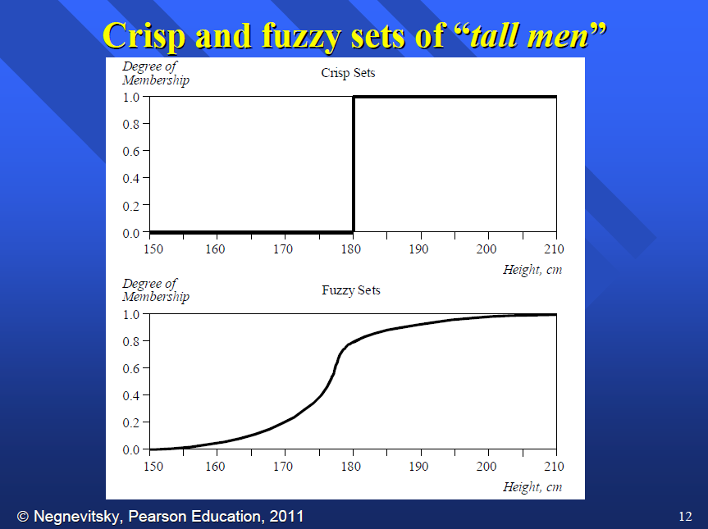
Fuzzy Sets & Fuzzy Logic
In a standard (crisp) set, an element is in or out.
In a fuzzy set, membership is expressed as a real number in [0, 1]
Fuzzy sets allow us to model a gradual transition or partial membership.
So a 4’8” tall adult man might have 0.0 degree membership in the set of tall men, a 5’8” man might have 0.4 degree membership in the set of tall men, and a 6’8” man might have 1.0 degree membership in the set of tall men
Various extensions of set theory allow computing degrees of membership as confidence intervals
Has been applied to produce fuzzy control systems, used in semantic textual analysis

Slide 40
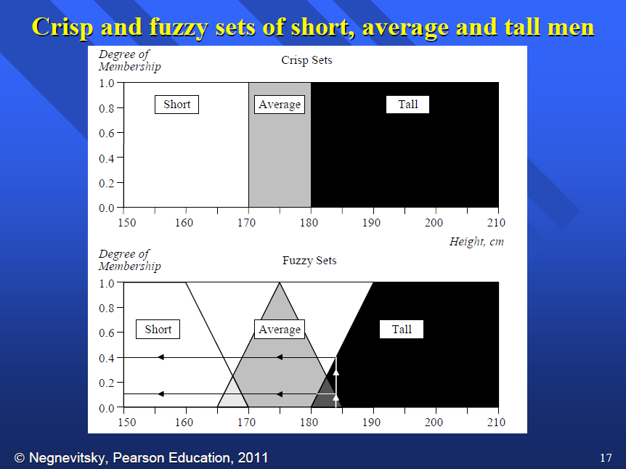
Fuzzy Sets & Fuzzy Logic

Slide 41
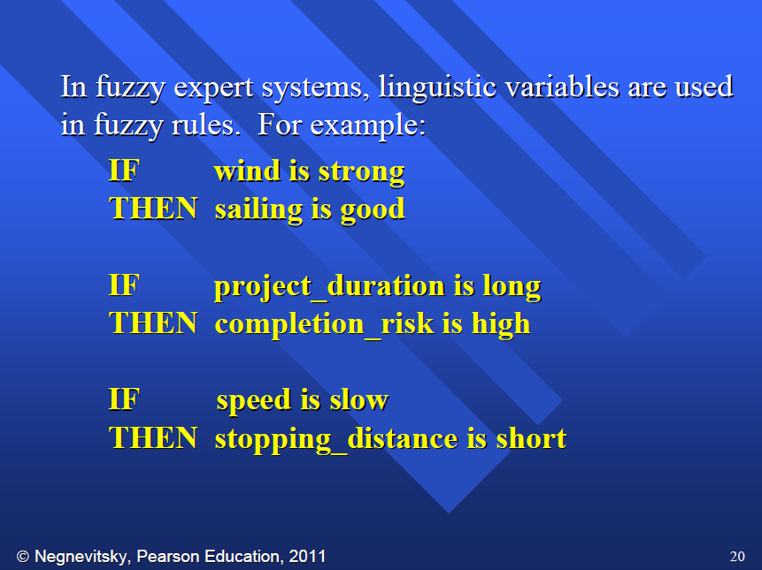
Fuzzy Sets & Fuzzy Logic

Slide 42
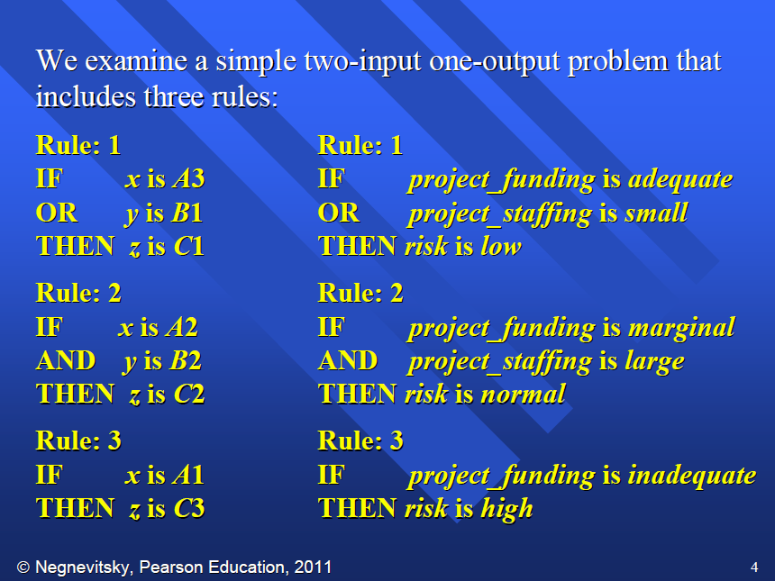
Fuzzy Sets & Fuzzy Logic

Slide 43
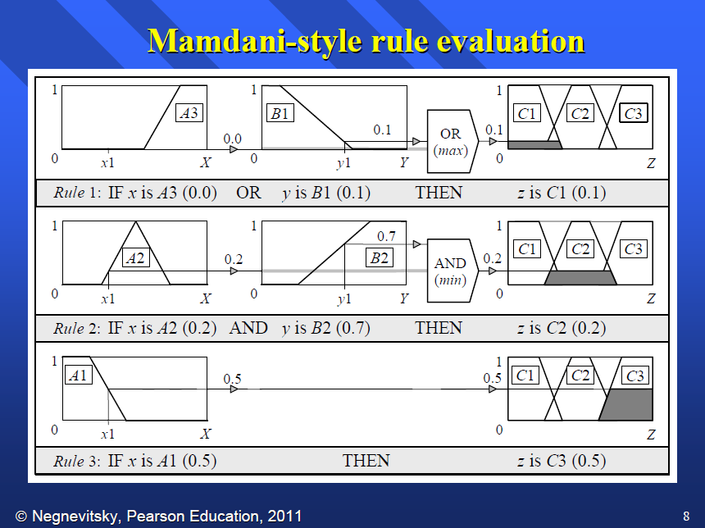
Fuzzy Sets & Fuzzy Logic

Slide 44
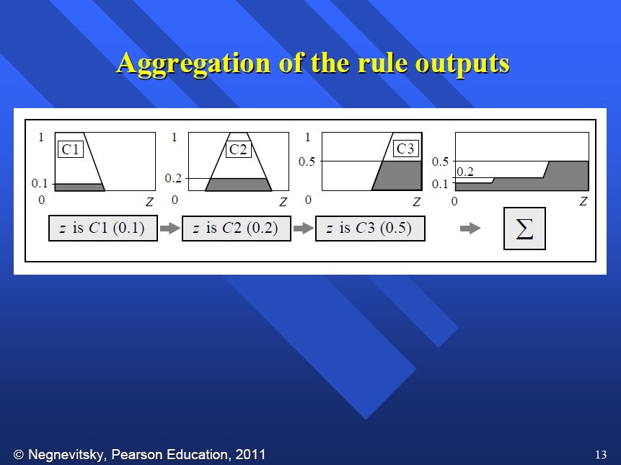
Fuzzy Sets & Fuzzy Logic

Slide 45
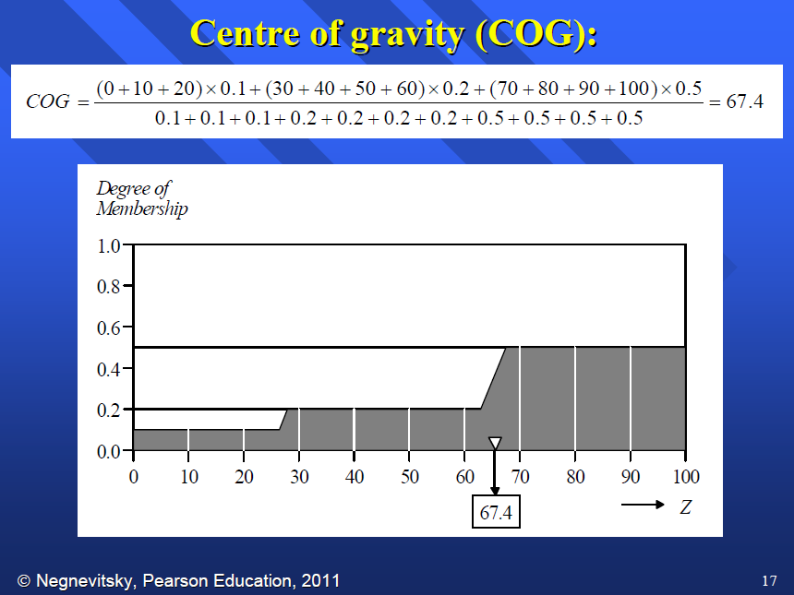
Fuzzy Sets & Fuzzy Logic

Slide 46
DETECTING relationships in data
Sometimes, the relationships in data are not known a priori
Properties, or features, of data may be used for classification
Things that belong together tend to have similar features

Slide 47
DETECTING relationships in data
SHOW PICTURE OF IRIS DATA

Slide 48
Clustering
Groups elements based upon minimizing average distance to cluster “centers”
Put another way, minimizes overall difference(s) between members of a cluster
k-means (isodata) algorithm most common
fuzzy c-means, possibilistic c-means, k-means++, many other variations
spectral clustering operates not on ellipsoids, but on minimizing dissimilarity between features (based upon given measure)
Most algorithms require specifying number of clusters

Slide 49
Classification
K-nearest neighbor or regression model applied to divide into categories
Divisions can be sharp or probabilistic
Some labeled data; classifier used to categorize unlabeled data
Need image!

Slide 50
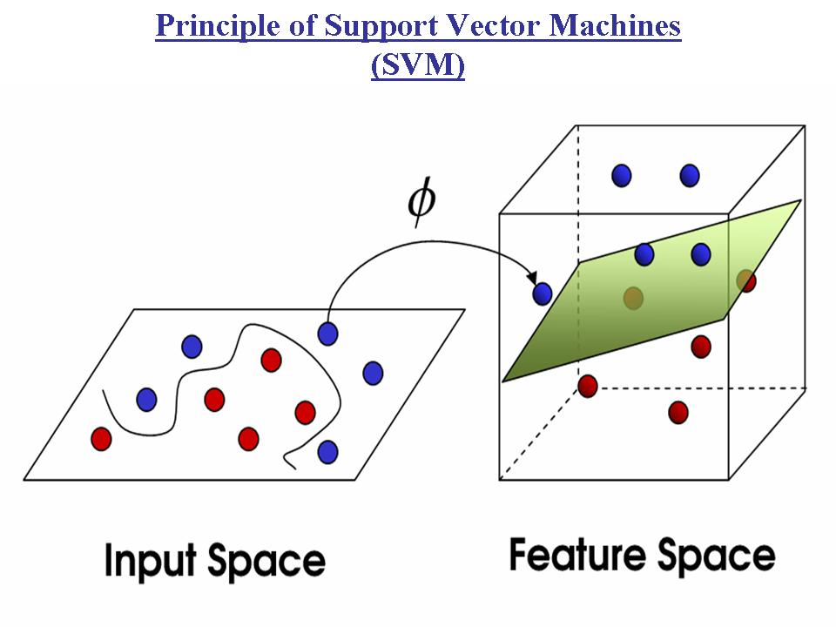
support vector machines
Identification of natural groupings within data
Linear classifiers attempt to identify boundaries between subgroups
Multivariate dividers are hyperplanes dividing high-dimensional space
Support Vector Machines attempt more general (not necessarily linear) fit for more accurate classification
As with any ML method, overtraining can be an issue

Slide 51
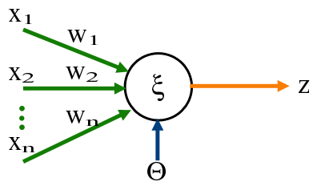
Perceptrons
Given some inputs (numeric, or one-hot for categorical data)
Multiply each input by an independent weight; sum and add bias;
Apply activation function (sigmoid, rectified linear, etc) to produce output
Originally proposed in 1940s.
Used in tandem can compute nonlinear functions such as XOR
Can learn correct output by adjusting weights, bias
Compare desired result, compute error, propagate backwards
An example of gradient descent learning

Slide 52
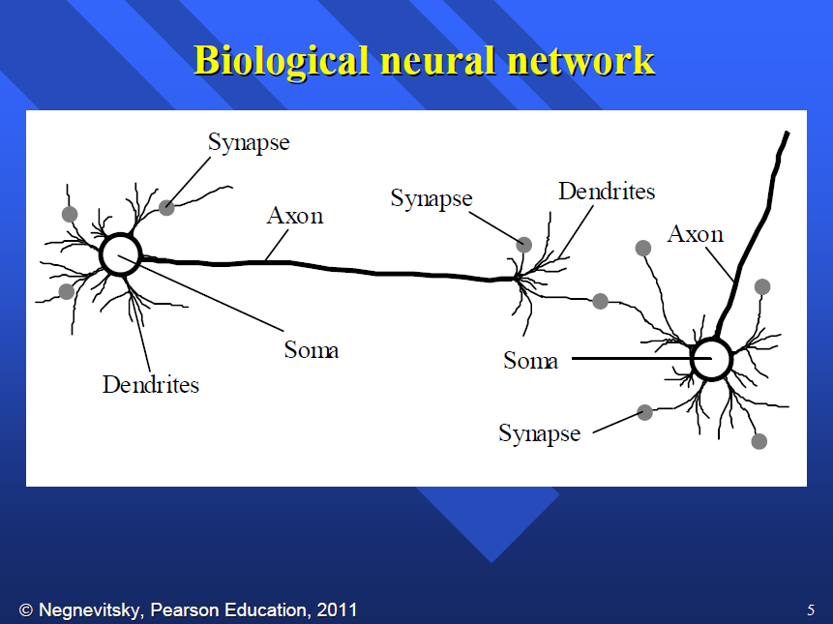
Neural Networks

Slide 53
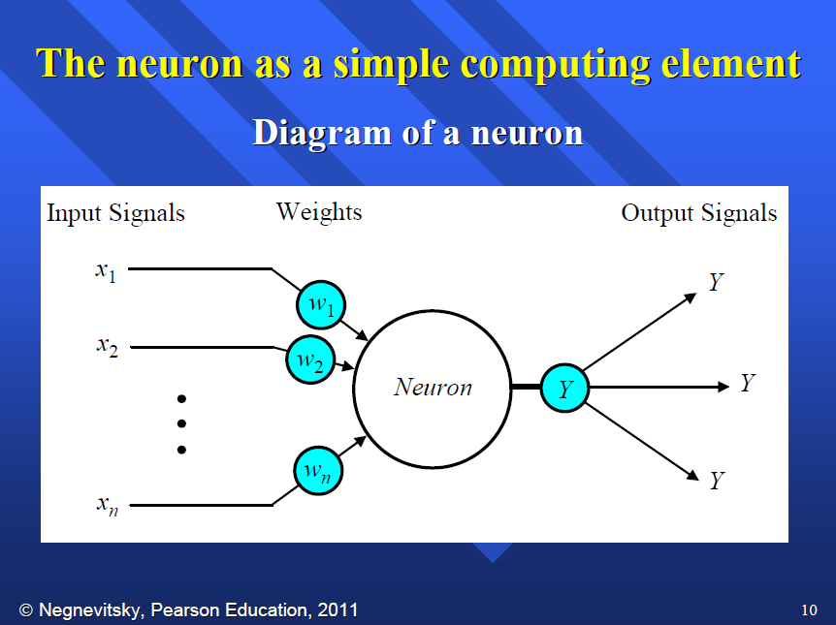
Neural Networks

Slide 54
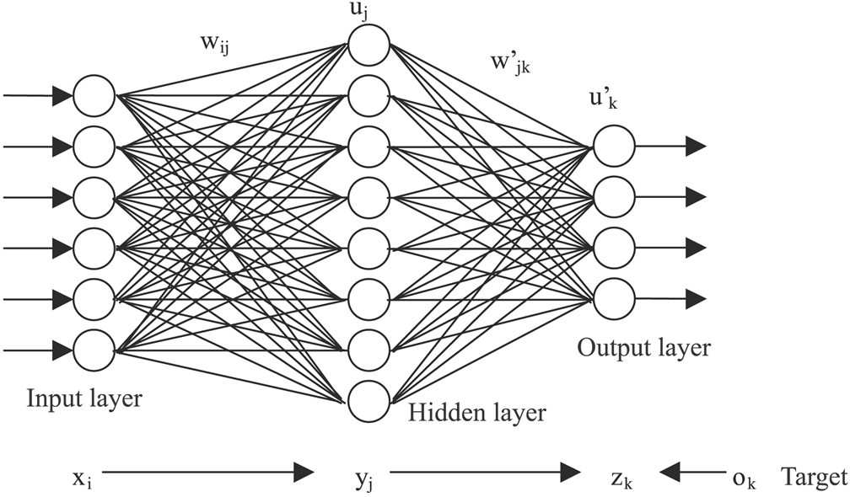
Neural Networks
Each input multiplied by some weight, all weighted inputs summed at each neuron
Repeated at each layer until output layer
Output may be normalized into probability distribution
Incorrect predictions are back propagated to adjust weights to improve future predictions
Other methods have also been used; genetic algorithms are popular
First proposed in 1940s, minor boom in 1980s, explosion in last decade as computation power has increased

Slide 55
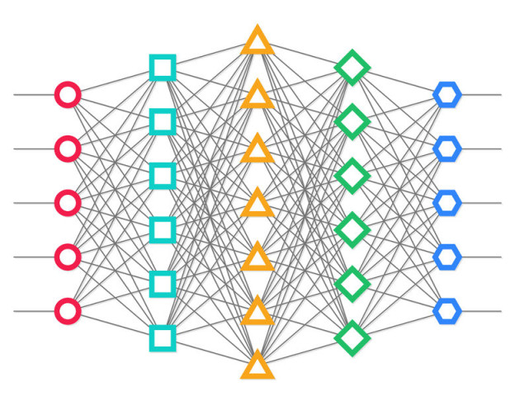
Variations on neural networks
Deep networks have multiple hidden layers, often of varying sizes, to detect higher-level features & interactions
Convolutional networks apply additional filters to detect features in surrounding inputs, e.g. feature detection in images
Time-delay neural networks have each input neuron remember its last several inputs, allowing inputs to be evaluated in context, useful in text analysis
Recurrent neural networks take an internal layer and feed it back into the input layer; this gives the network a memory
Siamese-twin networks presented with pairs of inputs, either “these are in the same category” or “these are in different categories.”
Networks can also be used for function evaluations: Model as sum of several normal curves at various heights, locations, & variances; gradient descent on heights/locations/variances to improve fit

Slide 56


Slide 57
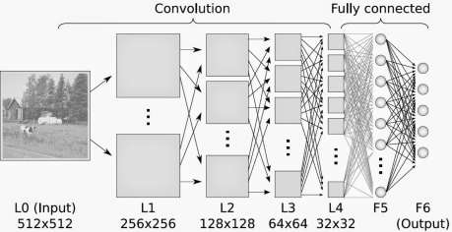
Applications of Neural Networks
Image analysis superior to humans
MRI, CT interpretation superior to most radiologists
Consumer analysis
Facial detection/analysis, face recognition
Many, many classification/categorization applications
Biased or inadequate data sets are almost always an issue in the real world

Slide 58
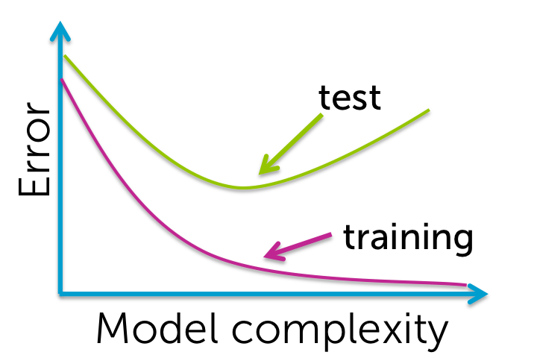
Avoiding overtraining
Any ML method can always do better on the same training data
Most methods very high-dimensional, more than enough to encode the training data directly
So learn on one set of data, then test on new data the system hasn’t seen before.
Holdout
N-fold cross validation
Leave out one
Once model is believed to be as good as it’s going to get, test on yet another validation set for estimate of real-world performance

Slide 59
Other areas of ai
Planning
Advanced decision making
Robotics
Simulations
…?

Slide 60
Now you are all experts on ai. (Ha!)
Questions…?
Comments..?
Thoughts?
What did we miss ?

Slide 61
Please complete the evaluation!
https://bit.ly/sigcse2019-workshops-saturday

Slide 62
So what do I do with all that information?
Your course can be classified on a rough 2-dimensional system:
Traditional AI or Computational Intelligence?
Theory-based, application-course, or technique based?
“Classic” overview course, extending ideas from data structures & linear algebra into new domains
Application-based approach, examining multiple techniques in a particular application area (“Autonomous vehicles” includes perception, route-finding, reasoning with uncertain information; “AI in health care” covers decision trees, health informatics, etc.)
Technique-based (course-long focus on neural network systems, Bayesian reasoning, etc.)

Slide 63
Classic overview course
Typically start with brute-force search, move on to more advanced methods
Can slide from AI into ML/CI or keep it entirely within “traditional” AI course
Can expose to different languages & paradigms
Goal is general overview with some exposure to key areas
Degree of mathematical depth or programming rigor varies by setting

Slide 64
Application-based course
Some application area (industrial operations, autonomous vehicles, biomedical, business modeling, etc) is used as running example & framework throughout course
Can fit well with other programs at institution (business school, music school, etc)
Techniques chosen will vary depending on context area
Can provide a unique course attracting students from other majors
May require more curation effort to put a course together

Slide 65
Technique focused course
A particular technique or subject (neural networks, Bayesian reasoning, supervised learning) is chosen as course focus
Variations on this in different contexts are examined
Neural networks for image analysis
Neural networks for text analysis
Neural networks for classification
Neural networks for game move selection
Etc…
Requires deeper knowledge about this technique
Can dive in to much more detail and examine implementation options

Slide 66
Part II: HOW to proceed
What expertise do you have?
Build on that.

Slide 67
Part II: HOW to proceed
What expertise do you have?
Build on that.
Find a textbook.
Not just any textbook, but one that works for you.
Look at MANY
from textbook publishers
through interlibrary loan
don’t simply settle for the “most widely used” textbook (although it may be a fine choice!)

Slide 68
Part II: HOW to proceed
Find a textbook.
Not just any textbook, but one that works for you.
Look at MANY
from textbook publishers
through interlibrary loan
don’t simply settle for the “most widely used” textbook (although it may be a fine choice!)
What is your audience?

Slide 69
Part II: HOW to proceed
Find a textbook.
Not just any textbook, but one that works for you.
Look at MANY. Textbook publishers can get you started. Interlibrary loan can be your friend to peruse many books quickly – often quicker than from the publisher. Don’t simply settle for the “most widely used” textbook (although it may be a fine choice!).
Develop your syllabus around your chosen textbook.
A textbook that flows well for you will greatly aid the process of developing a new course in an unfamiliar field.

Slide 70
Part II: HOW to proceed
Develop your syllabus around your chosen textbook.
A textbook that flows well for you will greatly aid the process of developing a new course in an unfamiliar field.
EXAMPLE
Heise CS 441 syllabus / Negnevitsky text
topics == chapters

Slide 71
Part II: PRE-REQUISITES
Develop your syllabus around your chosen textbook.
A textbook that flows well for you will greatly aid the process of developing a new course in an unfamiliar field.
What are appropriate pre-requisites for YOUR class?
Where will your AI course fit in the curriculum?
Into what curriculum will your AI course fit?
What are reasonable expectations for prospective AI students in your class?

Slide 72
Part II: PRE-REQUISITES
Pre-requisite option #1: Full-bore
Algorithms and data structures
Linear algebra
Mathematical statistics
Discrete mathematics
Calculus
Suitable for computer engineering or computer science

Slide 73
Part II: PRE-REQUISITES
Pre-requisite option #2: Math-lite
Intro programming
Elementary statistics
Suitable for computer information systems, MBA/MIS
Quote from back cover of Negnevitsky:
“This book, evolving from lectures given to students with little knowledge of calculus, assumes no prior programming experience… The main attraction of the author’s approach is in his deliberate de-emphasising of the maths – just enough to give a valid treatment of the subject.”

Slide 74
Part II: Resources
Resources
Use your textbook! A good textbook may provide excellent resources.
Resources are not just add-ons to the text; they point you to other tools, sources, data sets, etc.

Slide 75
Part II: Resources
Resources
Use your textbook! A good textbook may provide excellent resources.
Resources are not just add-ons to the text; they point you to other tools, sources, data sets, etc.
Google/Wikipedia
Yes, it’s not all evil. Just be careful.
Easy to bog down and get confused, both for you and your students.

Slide 76
Part II: ReSources
Resources
Use your textbook! A good textbook may provide excellent resources.
Resources are not just add-ons to the text; they point you to other tools, sources, data sets, etc.
Google/Wikipedia
Yes, it’s not all evil. Just be careful.
Easy to bog down and get confused, both for you and your students.
Talk to others!
Due to the breadth of – and popular interest in – AI, guest lectures are relatively easy
Many funded (e.g., NSF) projects encourage educational outreach; reach-out to colleagues at a not-too-distant R1 university

Slide 77
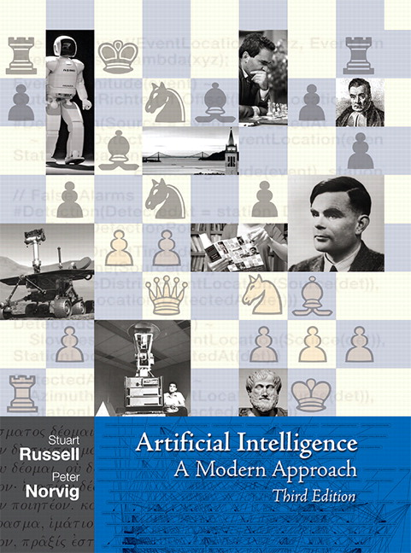


Part II: ReSources
Textbooks
Russell/Norvig
Lucci & Kopec
Negnevitsky
Keller et al.

Slide 78
Part II: ReSources
Other content resources
Vendor training (webinars, conference sessions, online material, software tools)
from Google, Microsoft, IBM, others
The Internet is your friend!
Many online courses, books, YouTube, etc.
YouTube has PBS’s “Crash Course” (high-level conceptual overview for general audience) and Google’s training course (aimed at serious professional) and everything in between
Like in a library, some “books” are not very good, others fantastic

Slide 79
Part II: ReSources
Software tools
MATLAB (http://www.mathworks.com, free trial, academic/student pricing)
Fuzzy Logic Toolbox
Machine Learning (formerly Neural Network) Toolbox
Global Optimization Toolbox (for evolutionary computation)
Java Expert System Shell (JESS, http://herzberg.ca.sandia.gov/jess)
FML (Fuzzy Markup Language)
PROLOG
Python – several ML libraries (PyBrain, PyTorch, TensorFlow)
WEKA

Slide 80
Part II: ReSources
Data sets
Fisher iris data
Weather data
Demographic / Election data
Constructed data / toy data sets (can be VERY useful for conveying concepts)
Healthcare data
Financial / stock market data
Some data is curated, some is not
Sites to start with:
Kaggle.com
Data.gov
CORGIS dataset project (https://think.cs.vt.edu/corgis/)

Slide 81
Part II: ReSources
Research
Academic / conference / journal papers
Transactions on Applied Perception
Transactions on Fuzzy Systems
Transactions on Neural Networks
FUZZ-IEEE
WCCI (World Congress on Computational Intelligence)
Etc., etc., etc. Maybe separate sources of papers from list of conferences

Slide 82
Part II: ReSources
Conferences
World Congress on Computational Intelligence (WCCI)
FUZZ-IEEE
Neural Networks (gotta remember name of the big one)
MLSP (Machine Learning and Signal Processing Conference)
Conferences in related fields (such as Society for Music Perception and Cognition Conference, SMPC)
Others. (Look at Keller text for possible sources, as well…)

Slide 83
Part II: Assignments
Re-implement textbook examples
Ask students to think of possible applications of techniques under discussion
Consider current events (e.g., election primary data)
Using tools vs. implementing methods
Data from “scratch” vs. prepared data files
Organized “challenges” (e.g., Go challenge through FUZZ-IEEE)

Slide 84
Part II: SO…. Discussion / Roundtable ???

Slide 85
Part II: SO…. Discussion / Roundtable ???
Should we have “activities” planned?
Or maybe posed questions for discussion?
Do we pick on participants?
Participants paid for this workshop. Do you think they are going to be active with questions, during or afterward?
We should be clear upfront that we want this to be interactive. Like my lectures, I’m happy to veer off-course if it meets students’ needs.
I have a really stupid idea. Ask me about it. I’m not willing to put it in print at this time. :-)

